Slide 1
CAPTCHA
Ateev Chopra
10 BCE 1023

Slide 2
WHAT IS CAPTCHA
CAPTCHA stands for "completely automated public Turing test” to tell computers and humans apart." What it means is, a program that can tell humans from machines using some type of generated test. A test most people can easily pass but a computer program cannot.

Slide 3
WHY CAPTCHA
The idea is to prevent spammers from using web bots to automatically post form data in order to create email accounts (for sending spam) or to submit feedback comments or guestbook entries containing spam messages. The text in the image is usually distorted to prevent the use of OCR (optical character reader) software to defeat the process. Hotmail, PayPal, Yahoo and a number of blog sites have employed this technique.

Slide 4
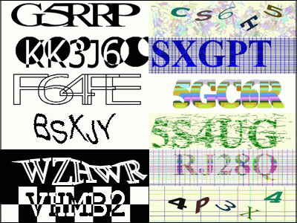
EXAMPLES

Slide 5
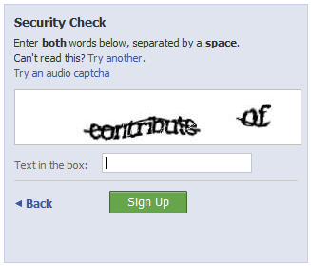
CAPTCHA PROGRAM

Slide 6
RETRY (MIN 3 RETRY)
BLOCKED
AFTER 3 RETRY
IF INCORRECT
CAPTCHA
(distorted characters)
VERIFICATION OF THE CHARACTERS ENTRED
Type Characters
USER
IF CORRECT
ACCESS GRANTED !!
USE CASE DIAGRAM

Slide 7
